Slide 1
UE19CS345 – Network Analysis and Mining
Course Project
Project Title :Binary Node Classification
Aryan Raj Chhetri B PES1UG19CS093
Kshitiz Kumar D PES1UG19CS235
Sathvik K G PES1UG19CS435
Shreyas M R H PES1UG19CS467

Slide 2
Topic and its uniqueness
PROBLEM STATEMENT :
Finding different types of centrality in our network for community detection and performing binary node classification .
LAB EVALUATIONS
i) Loading all the dataset files
ii) Performing network visualisation using different centrality measures
iii) Getting Graph and node stats
iv) Calculating sorted page rank
v) Use community Louvain to detect different communities in our graph
vi) Performing Binary node classification (Mapping node urls and links to int ids) using GCN by passing dgl gegraph to it.
vii) Performing training on our data set, validating it and testing it.

Slide 3
Topic and its uniqueness
LAB EVALUATIONS cont…
viii) Import and setup graphconv function and create the model
ix) Prepare the train function to train our model through various models and calculate training testing and validation accuracy
x) Running the model(max accuracy testing)
Why you think this project is interesting or unique
We are doing node classification using GCN.This is an important and interesting topic in graph ml which has not been implemented in our course learning.

Slide 4
Dataset
The dataset has been taken from https://linqs-data.soe.ucsc.edu/public/lbc/TerroristRel.tgz
size–there are 5 files(nodes, label, labels, edges, feat).
Nodes contains all the nodes -1293
Number of edges – 6344
Attributes-Labels can be classified as Arson, Bombing, Kidnapping, NBCR attack, other attack, weapon attack

Slide 5
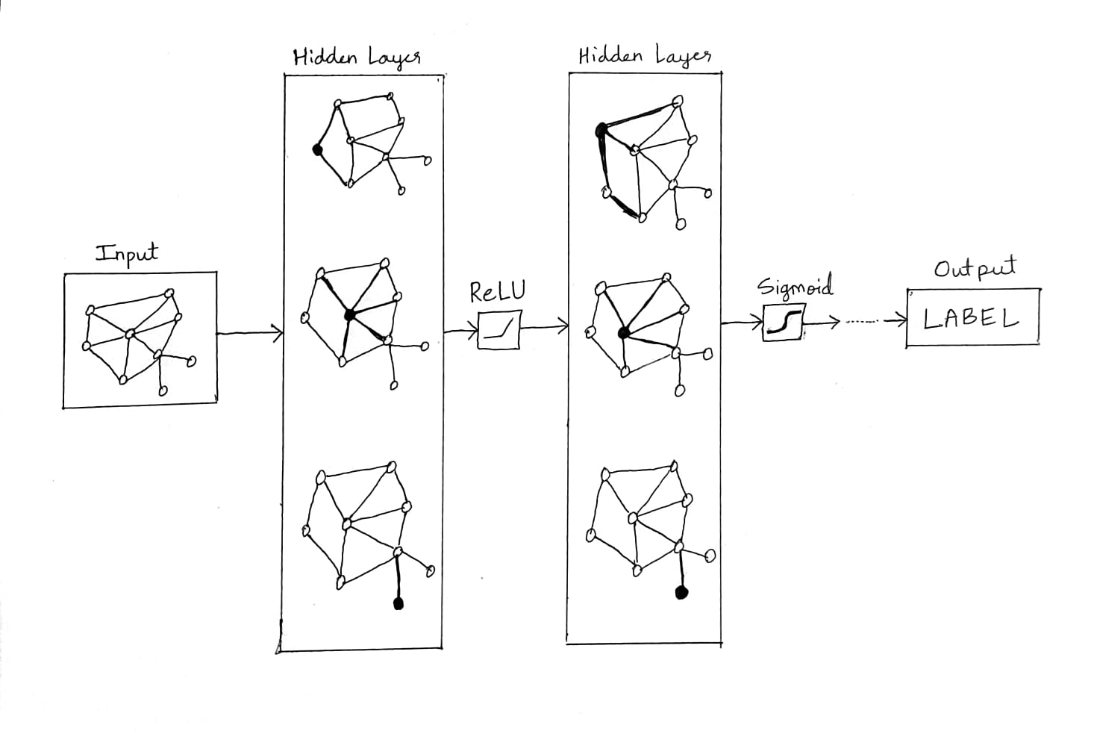
Overall design or approach in a free hand diagram
Implementing 2 layer GCN for binary node classification:

Slide 6
Final results
We have used accuracy as the metric for all the data splits.
Max accuracy for each are :
i) Validation set-89.1%
ii) Testing set – 83.3%

Slide 7
Quantity and quality of work
no | Code functionality | % Complete | Runs without problem (Y/N)
i) | Loading all the dataset files | 100 | Y
ii) | Performing network visualisation using different centrality measures | 100 | Y
iii) | Calculating sorted page rank | 100 | Y
iv) | Use community Louvain to detect different communities in our graph | 100 | Y
v) | Performing Binary node classification | 100 | Y
vi) | Training our model through various models and calculate training testing and validation accuracy | 100 | Y

Slide 8
Top few learning
Serial No | Top learning in this project
1 | How to input a custom graph into a gnn using torch and dgl
2 | How to use Graph neural networks for predictive analysis
**************************************************** THE END***********************************************************

